Slide 1
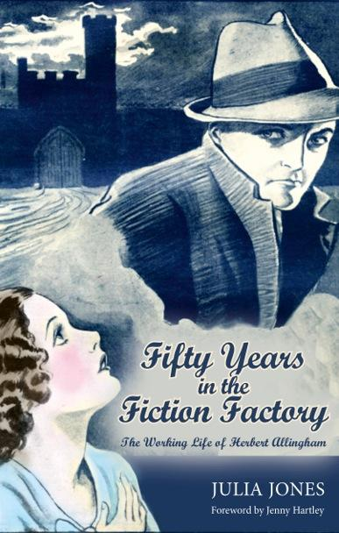
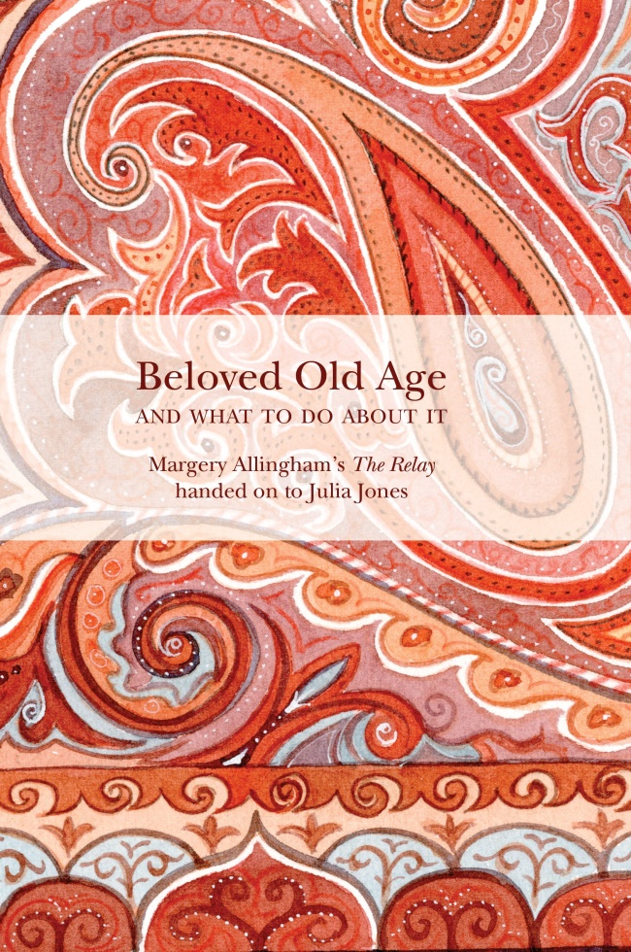
Prequel & Sequel
Margery Allingham Convention 14.4.2019
1967 – 1936 1959 - 2019

Slide 2
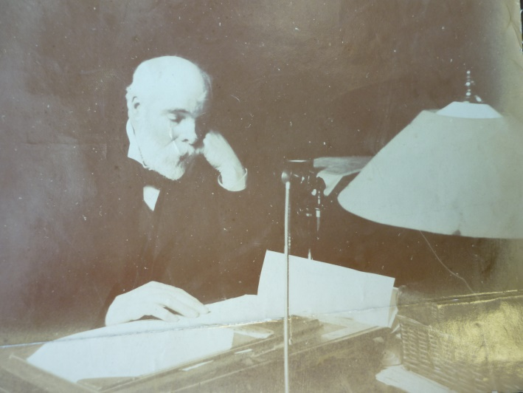
Four generations
The first was William, ‘man of property’, living in South London 1803-1874 as an apparent gentleman. He married Elizabeth Jane and they had eight children, three of whom were apprenticed as printers.
James, Margery’s grandfather (1840 – 1920) was the oldest of the next generation. He used his legacy to found The Christian Globe + an advertising agency. He married Louisa & they had eight sons and a daughter.
John ‘Ralph Rollington’ was James’s wild brother. He founded three boys’ penny weeklies & was the father of Grace (an actress)
Emily Jane, Margery’s grandmother, was James’s sister. She married a photographer, Walter Hughes, and had three daughters + a son
James at his desk in Fleet Street
Herbert Allingham (1867-1936) Margery’s father, was James & Louisa’s 2nd son, the intellectual of that family. Four of his brothers had careers that were media-related.
Em Hughes, Margery’s mother, & her sister Maud were also in the business.
Fourth: Margery, Phil, Joyce – all of whom had working knowledge of media

Slide 3
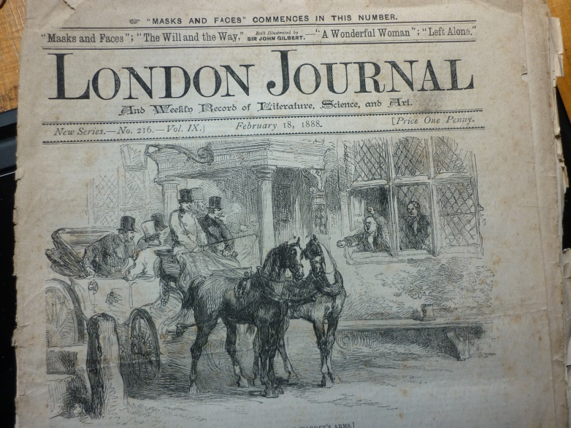
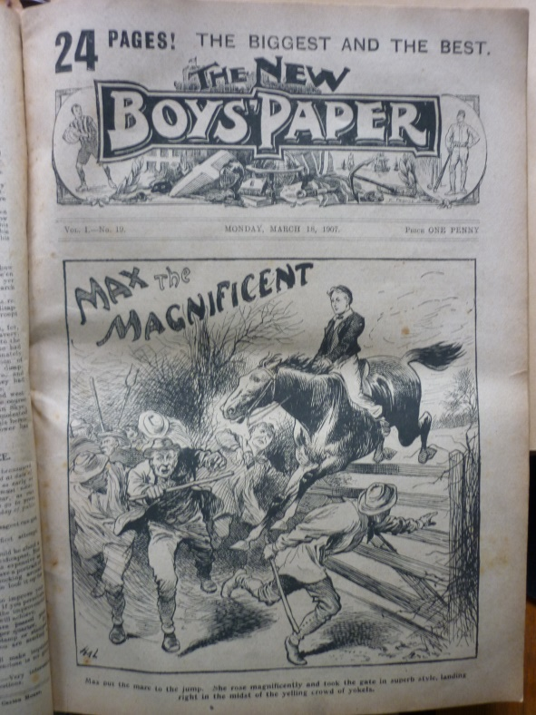
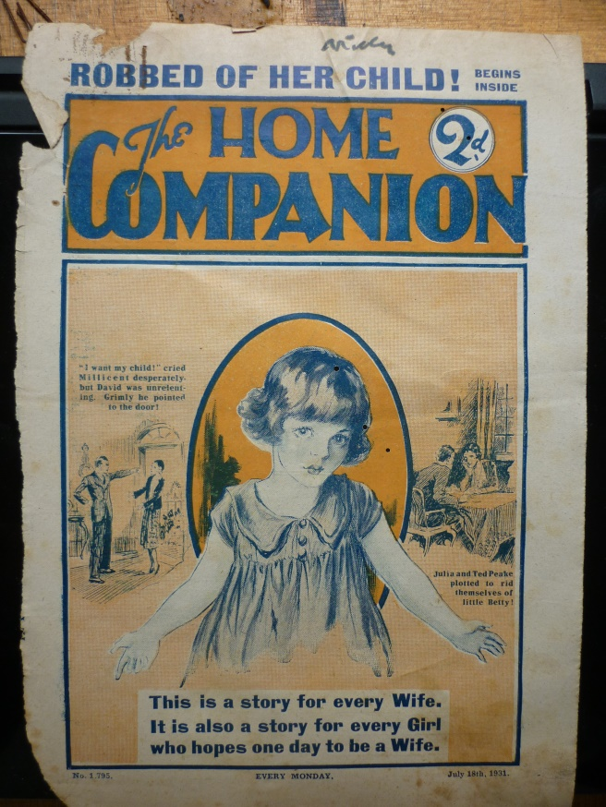
The great age of print
Herbert Allingham’s lifetime saw massive rise in literacy, in print technology, in media capitalism, in commercial fiction. By the time of his death this was being challenged by the film industry and by broadcast media.
Some significant factors – urbanisation, electoral reform, compulsory education, removal of advertising duties, reduced paper cost, more effective distribution, a few spare halfpennies. Entrepreneurial contemporaries eg the Harmsworth brothers.

Slide 4
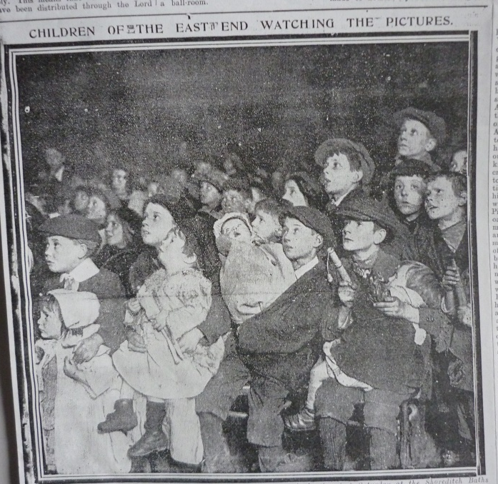
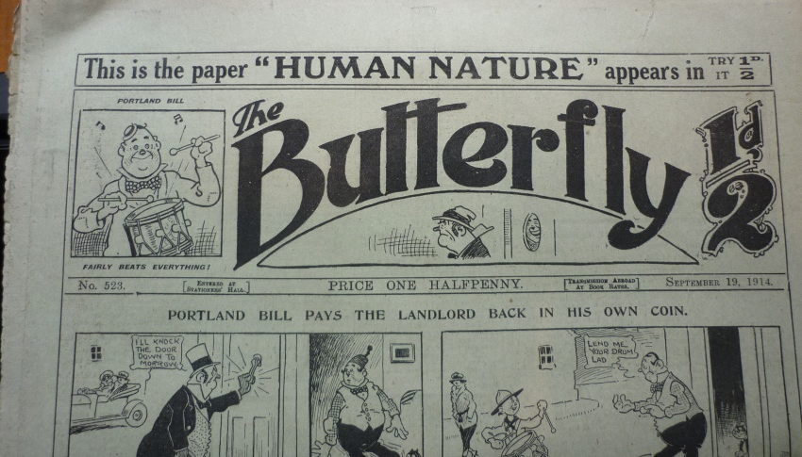
Herbert Allingham’s readers
“I know the common people. I get my living by studying them.” (Allingham to Northcliffe)
Readership changed as demographics changed, as family finances changed, as living conditions changed. Herbert was almost always writing for the poorest end of the mass market.
He began writing for a family readership – when the same penny paper had to be shared across the whole family. As boys became more obvious in late Victorian society and had some spending power, he also wrote for boys. In the first decade of the c20th he wrote for adolescents in the comics. Then, during WW1 he needed to entertain a mainly female audience. In the 1920s he adapted to the more fractured post war society and film fans. Finally, in the 1930s depression years, he appealed to an older readership, mainly female.

Slide 5
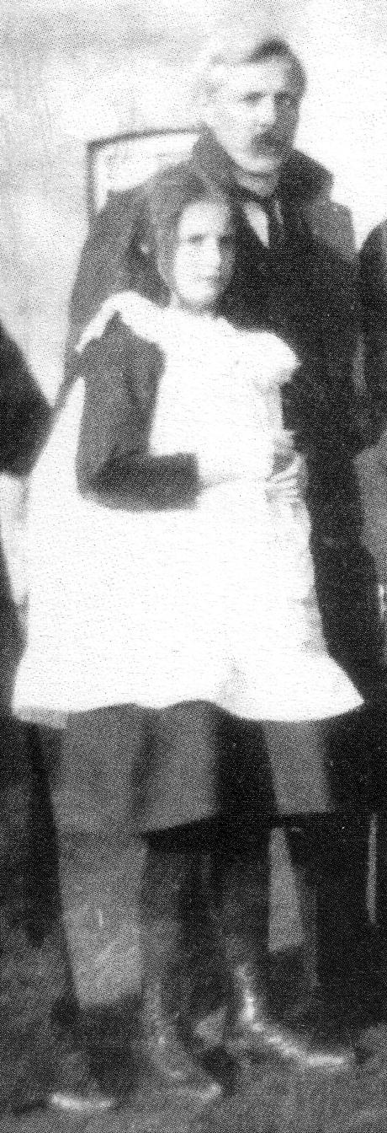
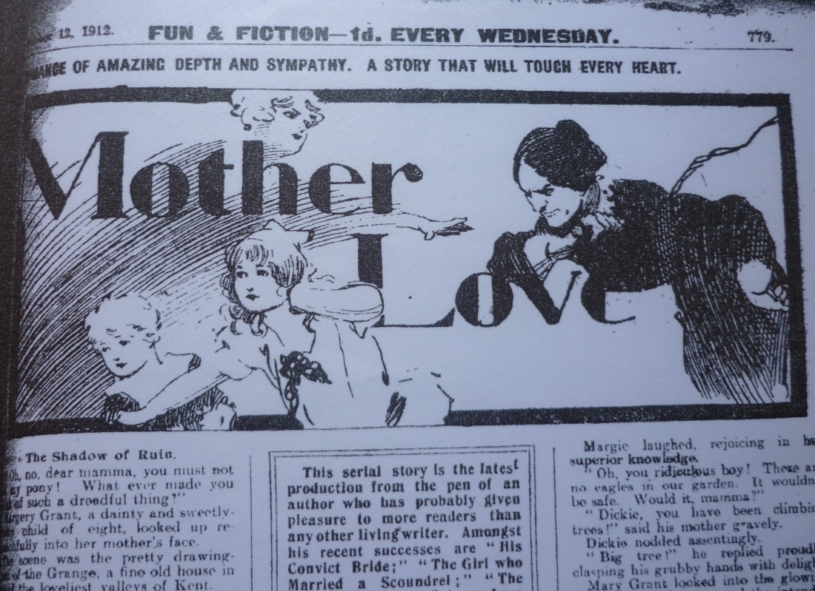
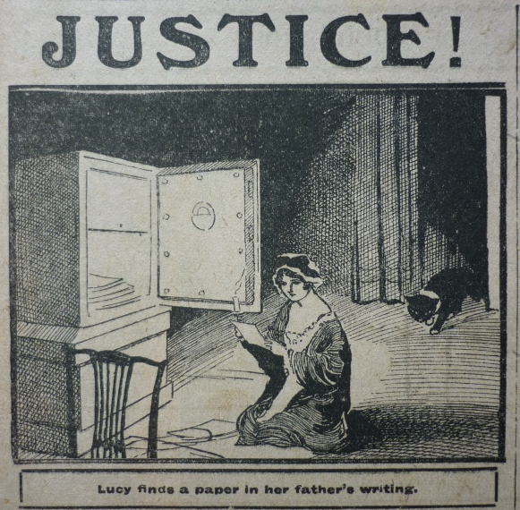
Herbert’s achievement
“He wrote hard and slowly, never once relaxing the enormous care that ensured his success.” M.A.
“the latest production from the pen of an author who has probably given pleasure to more readers than any other living writer”
Fun & Fiction (1912)
Understanding of melodrama
Use of language – the importance of cliché
Selection of plot archetypes
Fiction as journalism Working with editors
“He had a most exasperating life” M.A.

Slide 6
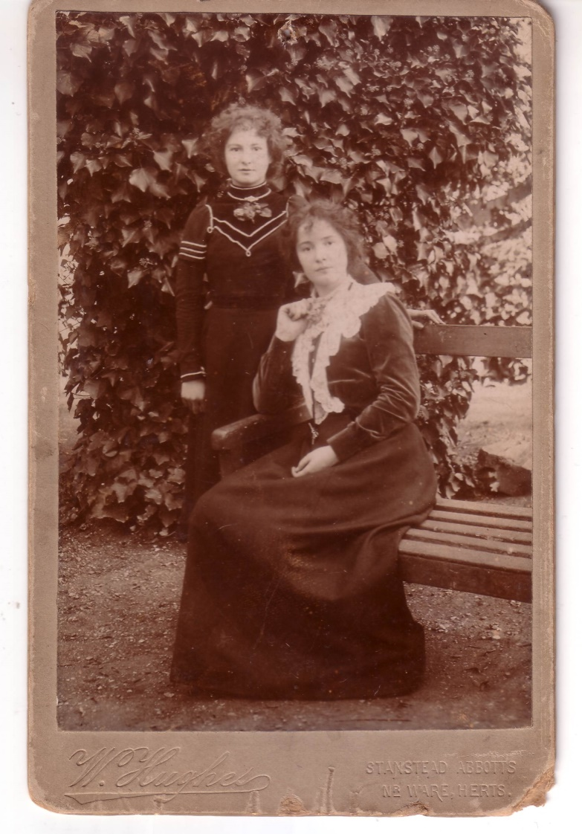
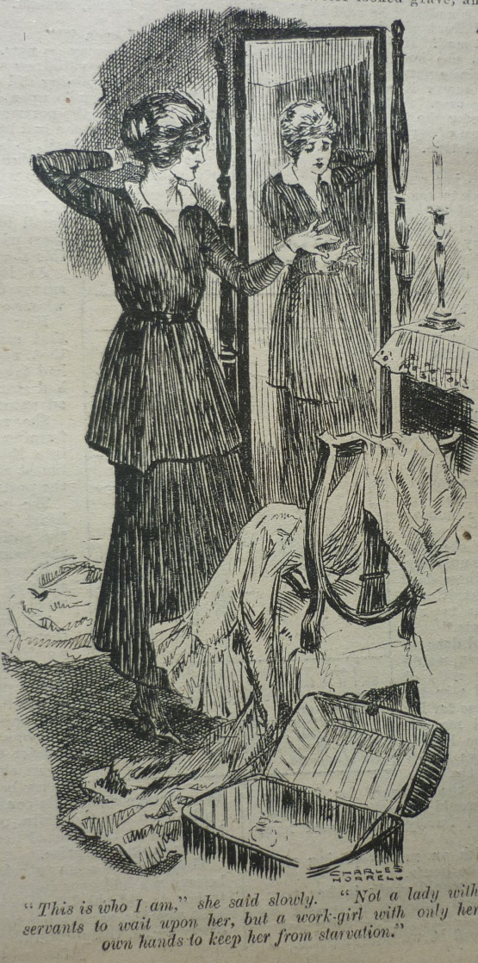
The Hughes sisters
Em (Margery’s mother) and Maud Hughes were two children of Emily Jane Allingham (the sister of James)
Their father, a photographer, used them as occasional models. The marriage was not a success and the girls (and their mother) had to work hard for their livings. Their brother emigrated to Canada. Their step sister a governess? Their younger sister died.
Em seated;
Maud standing,
“a flame-haired tartar”?
Her Own Game, published Woman’s Weekly, 1916 “This is who I am”

Slide 7
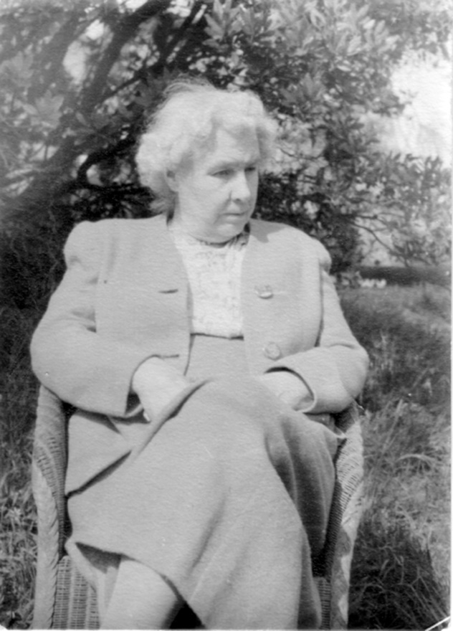
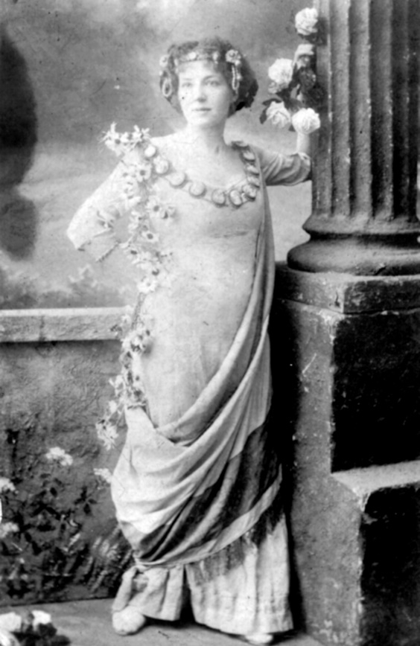
A family at its wits end
“Although it is obviously a beneficial thing for us to look after our own old people the question which remains is often the terrifying one: Whose life? Yours or ours?” M.A.
Em = falls & quarrels Maud = incapacitating stroke Grace = dementia

Slide 8
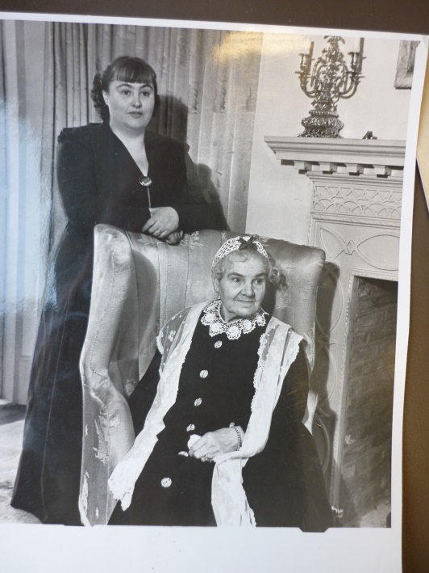
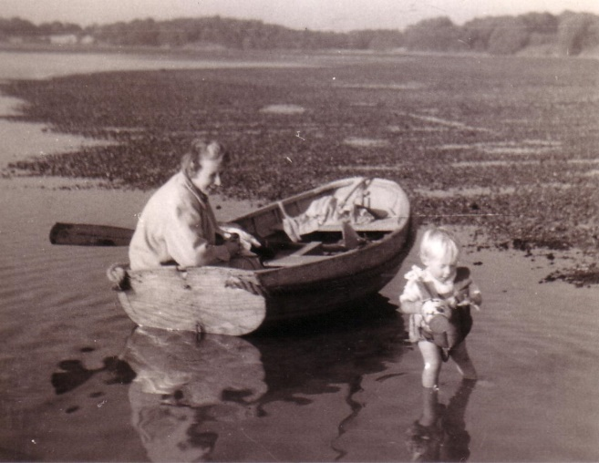
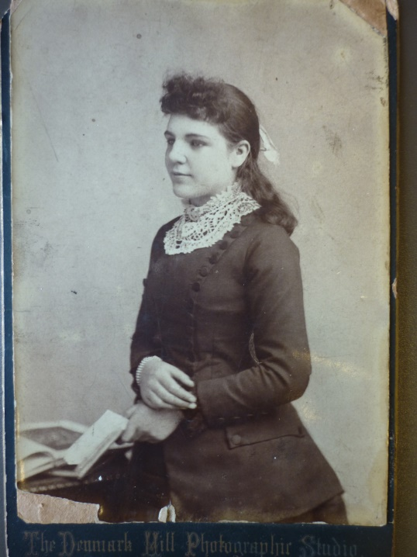
The Relay
“From an elderly point of view one does not have to consider the question of old age very long before it is clear that all one’s life one has been taking part in some kind of relay race, and that the period of age is that portion of it in which one passes the baton to the next sprinter. For a while we must run together…” M.A.
“The most remarkable source of human peace and security” M.A.
Dutiful daughter, Mary Webster, founder of the carers’ movement , wrote to the Times in 1963.
a “42nd cousin” (with Claudia Myatt)

Slide 9
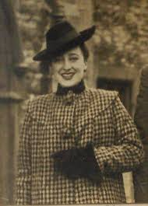
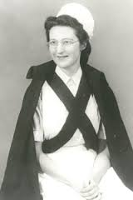
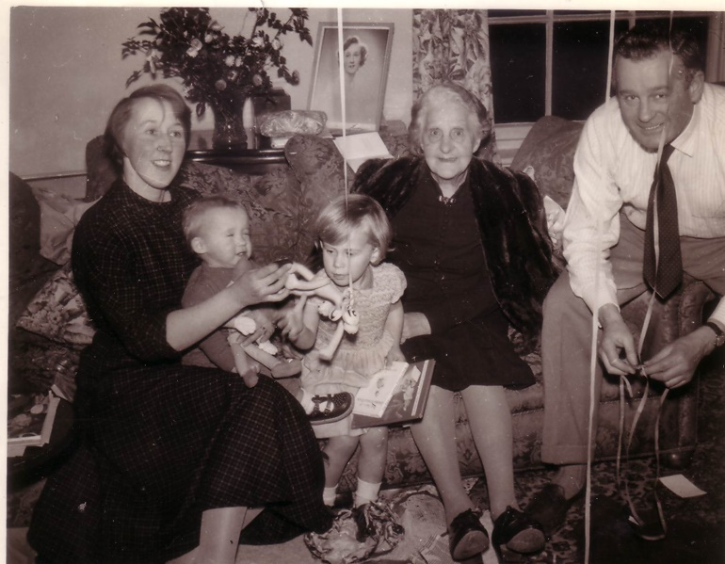
Old Age –what’s new?
“The habit of combining a reluctance to grow old oneself (a very healthy instinct) with ignorance of the facts of the subject may account for much of the quite unnatural terror connected with it” M.A.
The NHS was new when Margery & Joyce were caring for their mother and aunts. It hadn’t been there when she was looking after her grandmother.
Social care was limited though there were public institutions, long stay hospital wards, ‘homes’, and the beginnings of ideas such as the Abbeyfield project.
Dementia existed but was not in the forefront of the public mind as it is now. People with dementia were often housed in mental hospitals – Margery’s doctor, Russell Barton was ahead of his time writing about Institutional Neuroses
Barbara Robb (AEGIS) Cicely Saunders (hospice) Jones family Christmas 1958

Slide 10
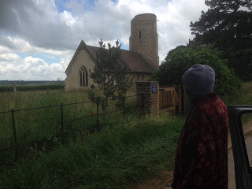
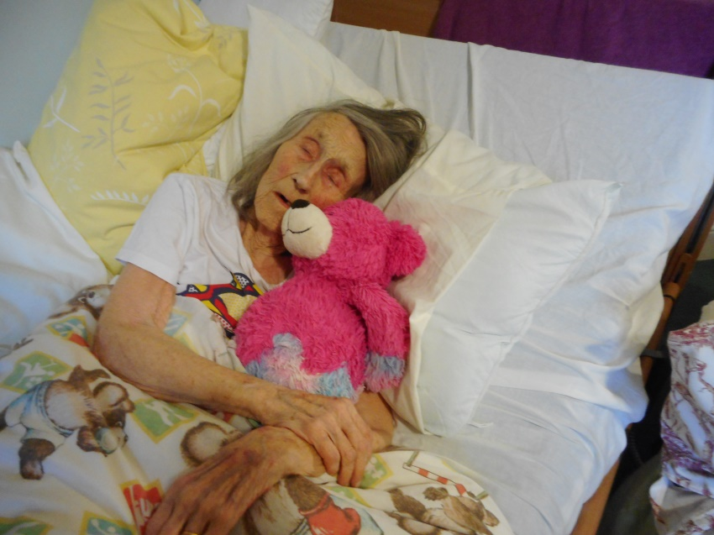
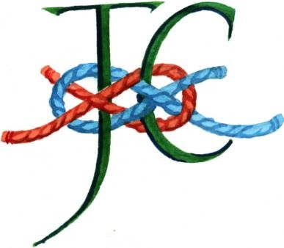
A personal legacy
“When this particular household was no longer needed the younger generation found themselves enriched in knowledge not only about old age but about themselves. They were able to look back with happiness and humour to an important part in their own evolution and found it good.” M.A.
”
It’s difficult to overstate the comfort and support that Margery’s Relay has given to me since I published Beloved Old Age . I have understood how these ideas can work in different places and, though this picture of my mother just days before she died brings tears to my eyes, I do not feel guilt or anger. Tomorrow (5.4.2019) she returns to Ramsholt which she left at that traumatic moment of ‘let go’ in June 2016. J.J.

