Slide 1
Fogginess: a comparison of Margery Allingham and the Queens of Crime
By
Mark Green

Slide 2
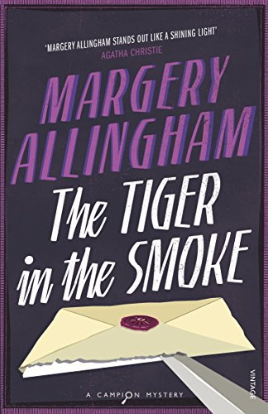
“…The fog was like a saffron blanket soaked in ice-water. It had hung over London all day and at last was beginning to descend. The sky was yellow as a duster and the rest was granular black, overprinted in grey and lightened by occasional slivers of bright fish colour as a policeman turned his west cape.
…The fog had crept into the taxi where it crouched panting in a traffic jam. It oozed in ungenially, to smear sooty fingers over the two elegant young people who sat inside.”

Slide 3
Gunning Fog Index:11.2
(opening passage)

Slide 4
Gunning Fog Index
Measure of “Readability”
Developed by Robert Gunning
  US Newspapers in 1940s
Based on length of sentences and use of “complicated words”
Formula:
0.4 x ((words/sentences) + 100 x (complicated words/words))
Approximates to years of education required to comprehend content
Needs to be under 12 for a “wider audience” to read easily
Under 8 for “near universal” comprehension

Slide 5
For example
The cat sat on the mat.
The black cat sat on the mat.
The ferocious black cat sat on the mat.
The ferocious black cat sat impatiently on the mat waiting for Albert Campion’s arrival home to feed him his delicious dinner of sardines containing absolutely no arsenic.
2.4
2.8
8.2
19.69

Slide 6
Gunning Fog Index: 8.72
(overall)

Slide 8
Average Fog Index = 8.99

Slide 9
11.88

Slide 10
Narrative Arc of a Novel
Beginning => Middle => End
Hypothesis:
Beginning – easy readability to draw reader into novel
Middle – denser text as plot/investigation unfolds in all its complexity
End – whisk the reader to the climax (page-turner)
Implies Fog index starts low, rises in middle then reduces towards end

Slide 14
Death of A Ghost Dancers in Mourning

Slide 26
Conclusions
Allingham, Christie and Marsh exhibit same pattern of readability over time
  Dip in third decade
  Generally rising demands on readership
No readability evidence to support “waning of powers” in Christie’s later books
Possible readability evidence of waning of powers in Marsh’s later books

